Slide 1


Pinakin SHAH

Slide 2
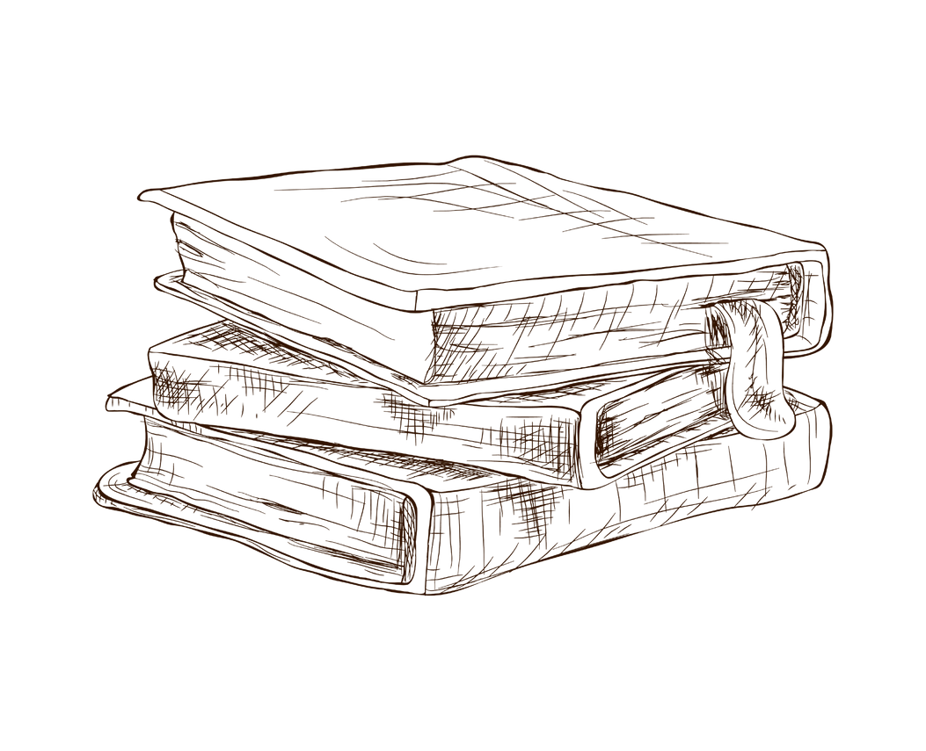
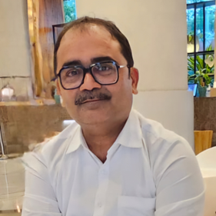
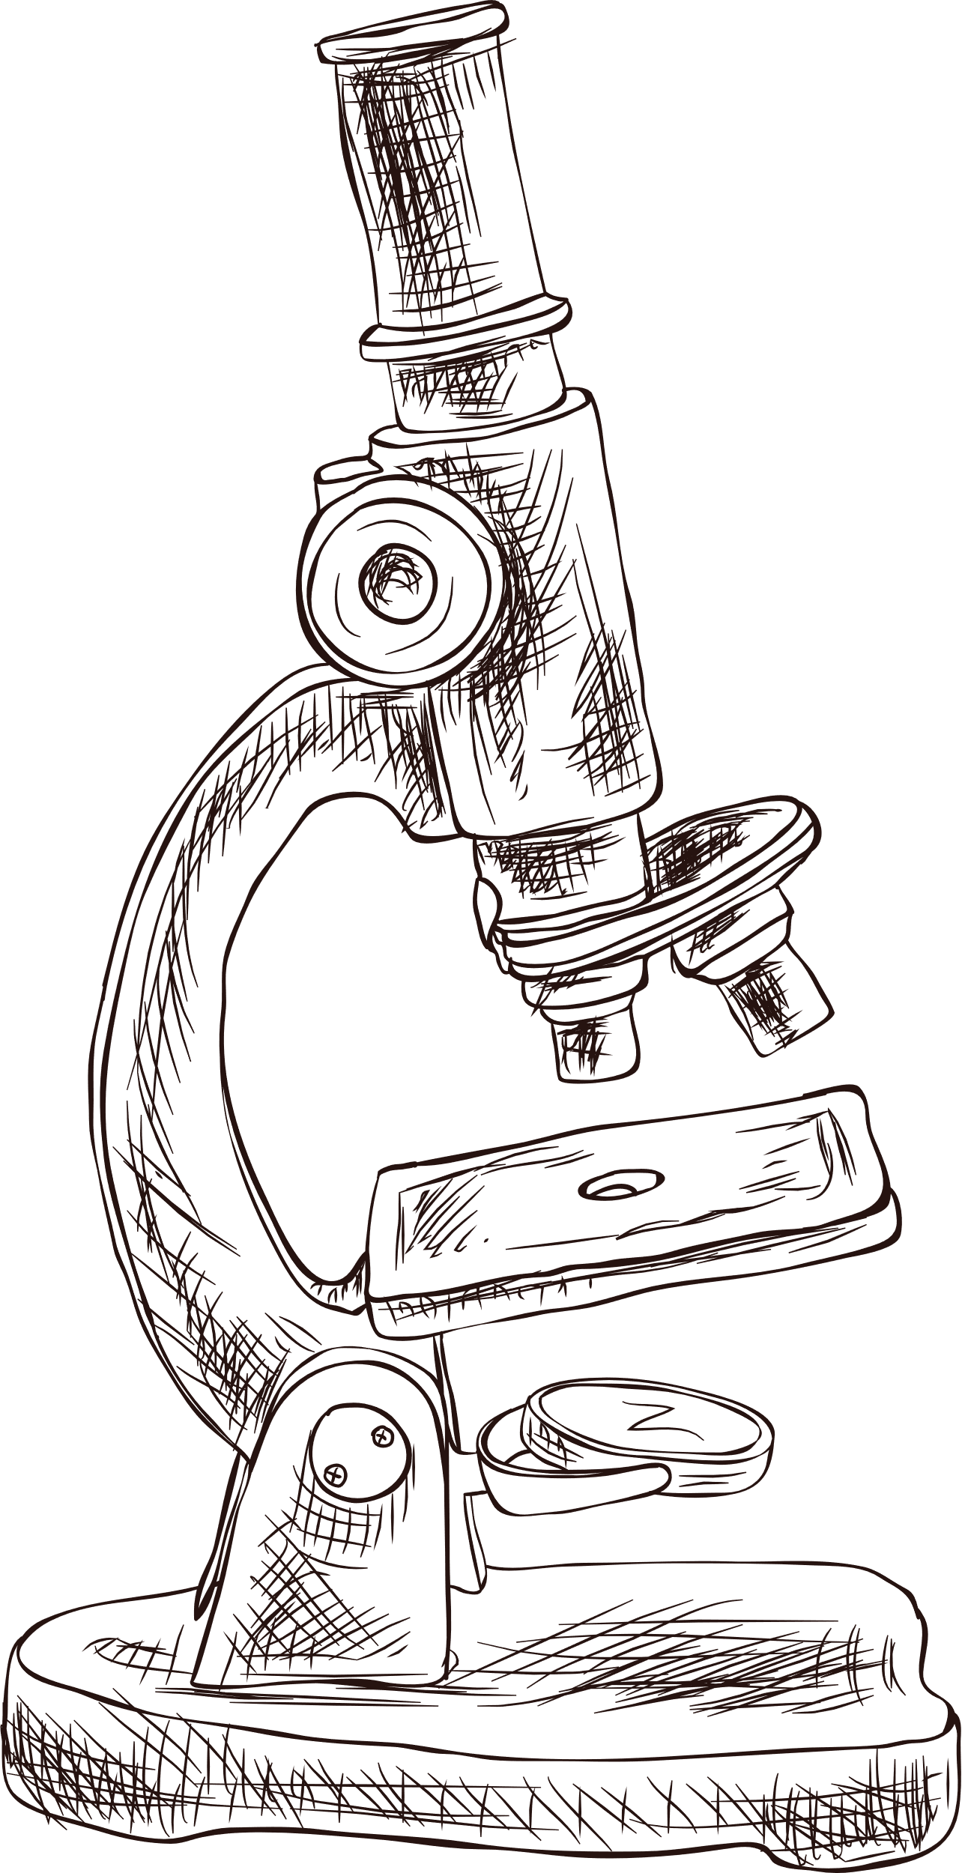
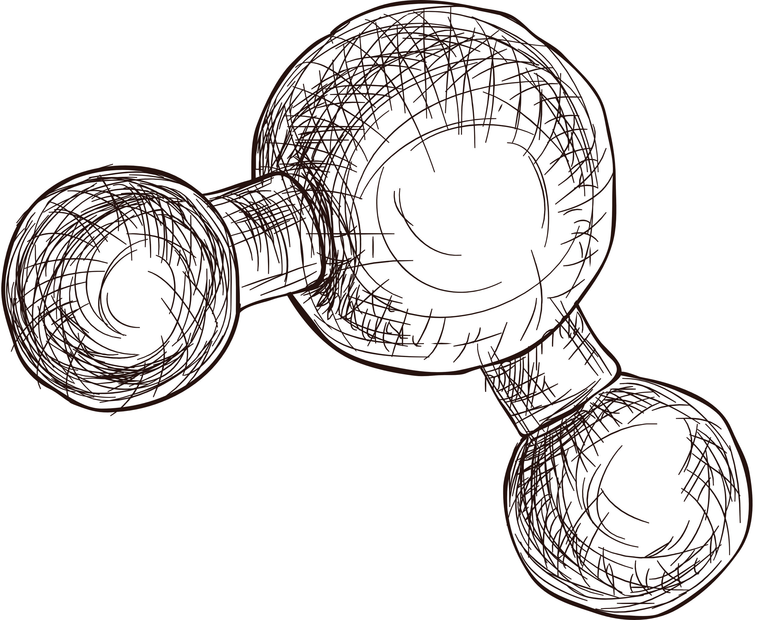
Professional Overview
Transforming microbiological excellence in Global pharmaceutical, medical device and consumer healthcare industries for last 30 years.
Microbiologist by qualification with Certificate in Management Development Program from AIM (Manila).
Certified Greenbelt in Process Excellence Six Sigma.
Extensive experience in Quality and R&D Microbiology of Johnson & Johnson Pvt Ltd and Kenvue,driving strategic impact and operational excellence at Global level.

Slide 3




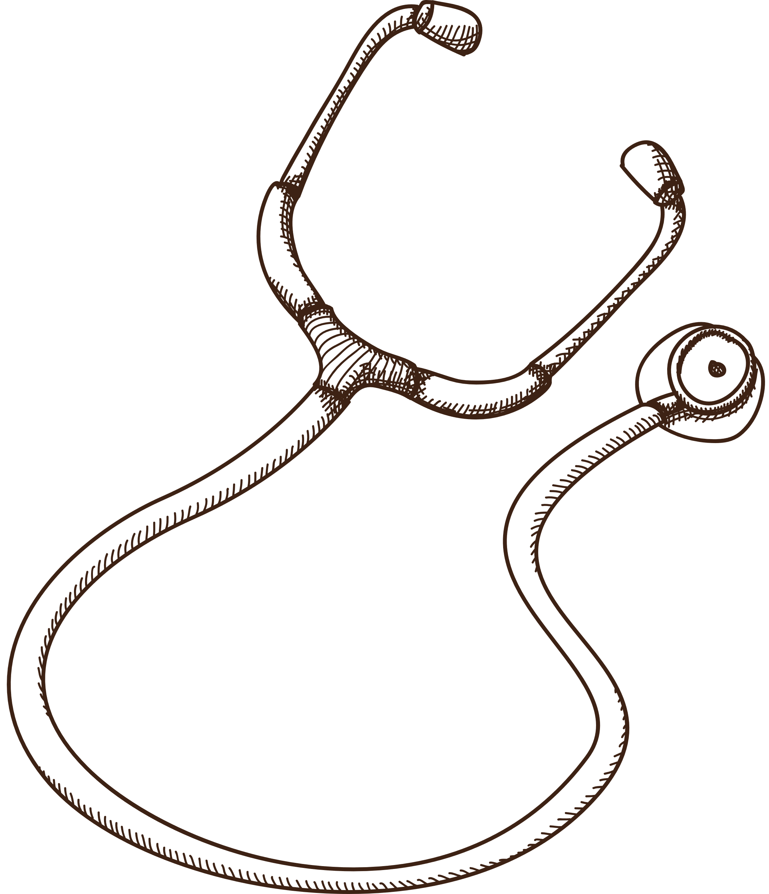
Core Competencies
Micro bio.
Expertise
Risk Assessments
Audits
Failure
Investigations
Claims & Demos
Proven track record in implementing end to end microbiological excellence (Quality and R&D)and releasing robust quality products rapidly to the markets
Expertise in microbiology risk assessment of formulations and raw materials with remediation plans
Conducting GMP audits for Microbiology labs and manufacturing areas.
Preparing lab facilities and teams for Regulatory and Quality Compliance audits/inspections
Marketed Product failure investigations, CAPA and risk assessment for Objectionable organisms.
Creating and supporting new microbiological claims on the products

Slide 4





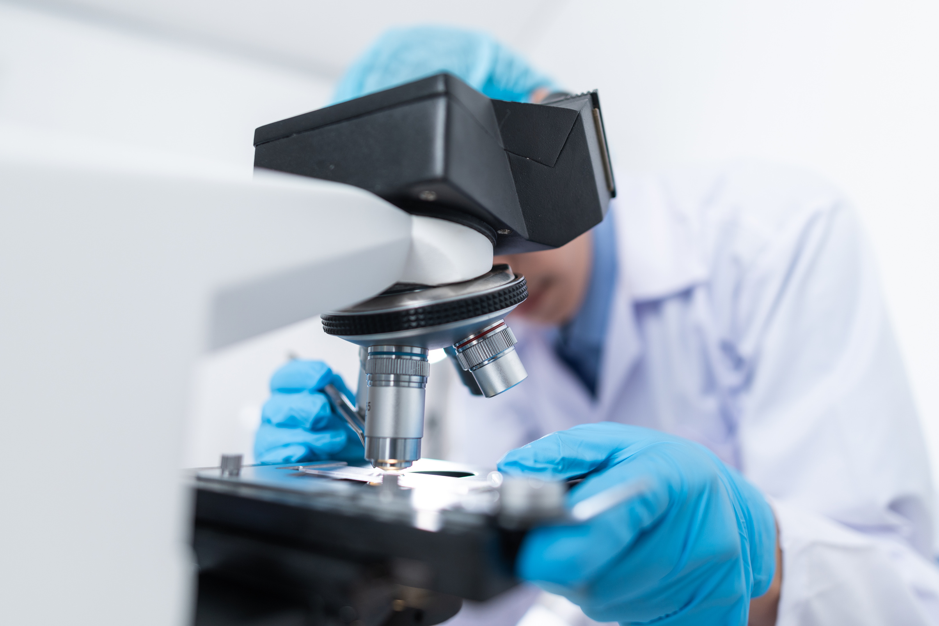
Key Achievements
Deployed Rapid microbiology methods for product release and led Global projects on Innovation and Simplification (Sterilization elimination, optimization of stability, product preservation etc).
Instrumental in developing comprehensive risk level based assessment Programs/models for Formulations and Raw materials.
Led three consecutive successful certification/accreditation of Microbiology laboratory for US FDA (with Zero 483 Observation).Conducted microbiological GMP audits for mfg sites, laboratories and suppliers.
Investigated and identified correct root causes for complex failures/contamination issues in manufacturing sites of APAC region.
Developed and supported multiple claims and demos for consumer cosmetic brands.

Slide 5

Offered Services
Microbiology risk assessment across the entire manufacturing and New product development process (including RMs and Packaging materials)
Drive/facilitate Rapid microbiological methods for quick (24 hrs to 72 hrs) product release to the markets
Implement Data Integrity risk assessment (DIRA) and contamination control strategies (CCS)
Preparation of facility and team for regulatory and stakeholder audits, including writing audit action plans, and CAPA post-audits
Establishing Microbiological labs and Quality Management Systems (QMS) for greenfield projects
Audits of microbiology laboratories, facilities and suppliers
Failure investigation/trouble shooting at manufacturing sites and in the laboratories,with remediation of identified gaps
Facilitate/lead creation of new microbiological claims and demos (including pre and probiotics)
Microbiological Qualification of sterilization processes for Steam, Gamma and EO
Prepare organization for Lab of the future/future generation of microbiologists

Slide 6



Contact Details
+91 9821937240
1008vipa@gmail.com
www.linkedin.com/in/pinakin-shah-63002235/

